Slide 1


MDaS Bootcamp: Python for Machine Learning Karuna Bhaila, Alycia Carey, Xintao Wu

Slide 2
Outline
Two 1.5-hour sessions; we will cover following topics
Data Preprocessing
Cleaning data
Missing values
Continuous Attributes
Machine Learning
Decision Trees (DT)
Naïve Bayes (NB)
Logistic Regression (LR)
Support Vector Machines (SVMs)
Neural Networks (NNs)

Slide 3
What is machine learning?
Specifically, statistical machine learning
Divided into supervised learning, unsupervised learning, and reinforcement learning
No support for RL in scikit-learn
High-level: learn to predict something from data
Slides adapted from https://jorge-a-mendez.github.io/teaching/ and
https://hanj.cs.illinois.edu/bk3/bk3_slidesindex.htm
Notes:
Was or will be a unit for unsupervised learning, clustering

Slide 4
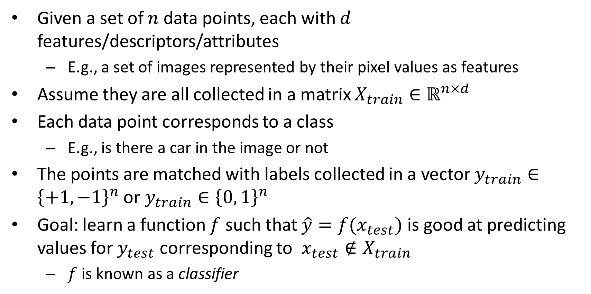
Supervised learning: Classification
Given a set of $n$ data points, each with $d$ features/descriptors/attributes
E.g., a set of images represented by their pixel values as features
Assume they are all collected in a matrix $X_{train}∈ℝ^{n×d}$
Each data point corresponds to a class
E.g., is there a car in the image or not
The points are matched with labels collected in a vector $y_{train}∈{\left\{+1,−1\right\}}^{n}$ or $y_{train}∈{\left\{0, 1\right\}}^{n}$
Goal: learn a function $f$ such that $\hat{y}=f(x_{test})$ is good at predicting values for $y_{test}$ corresponding to $x_{test}∉X_{train}$
$f$ is known as a classifier

Slide 5
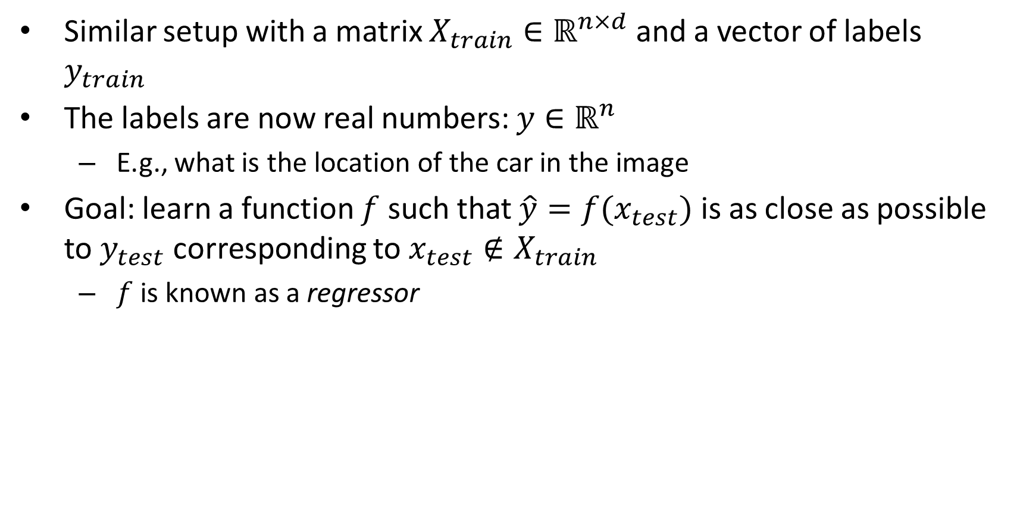
Supervised learning: Regression
Similar setup with a matrix $X_{train}∈ℝ^{n×d}$ and a vector of labels $y_{train}$
The labels are now real numbers: $y∈ℝ^{n}$
E.g., what is the location of the car in the image
Goal: learn a function $f$ such that $\hat{y}=f(x_{test})$ is as close as possible to $y_{test}$ corresponding to $x_{test}∉X_{train}$
$f$ is known as a regressor

Slide 6
Process: Model Construction
Classification
Algorithms
Training
Data
Classifier
(Model)
IF rank = ‘professor’
OR years > 6
THEN tenured = ‘yes’
Notes:
Visual example of what we are trying to achieve

Slide 7
Process: Using the model for prediction
Classifier
Testing
Data
Unseen Data
(Jeff, Professor, 4)
Tenured?

Slide 8
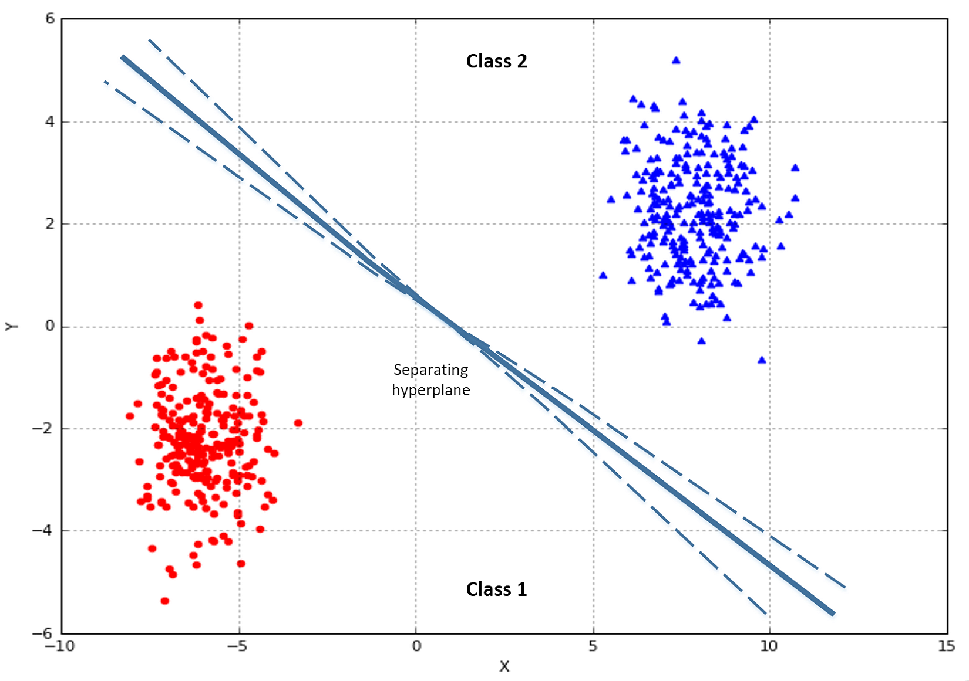
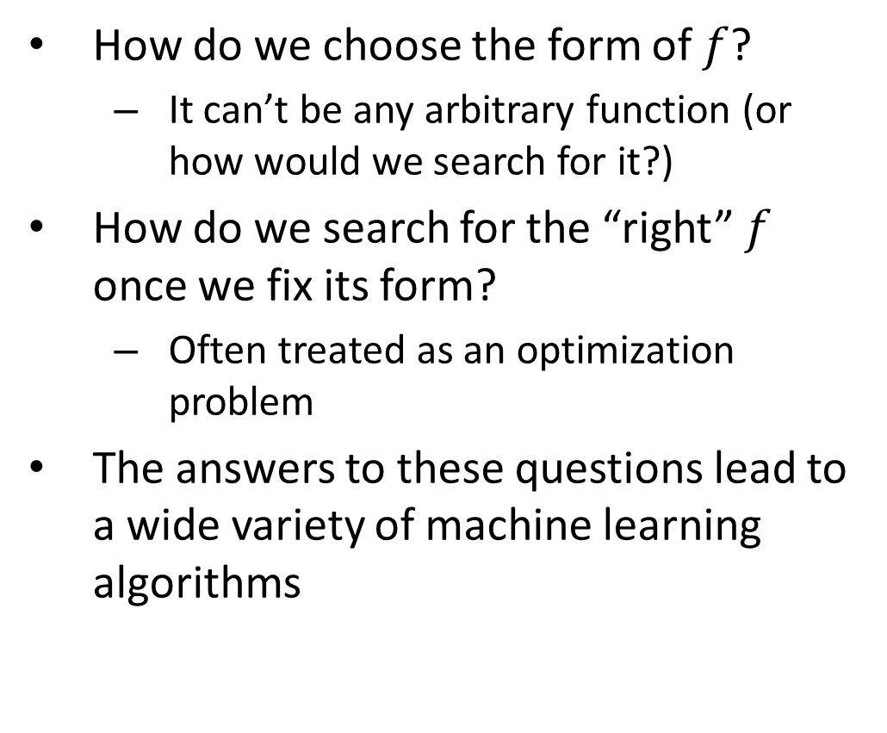
How to solve ML?
How do we choose the form of $f$?
It can’t be any arbitrary function (or how would we search for it?)
How do we search for the “right” $f$ once we fix its form?
Often treated as an optimization problem
The answers to these questions lead to a wide variety of machine learning algorithms
Notes:
Simple case: assume we have two features

Slide 9
ML in scikit-learn
Predictive data analysis tool for Python; uses SciPy, NumPy, and Matplotlib
Provides a selection of efficient tools for machine learning and statistical modeling
Methods
fit(X, y) — find the optimal weights
predict(X) — return the predicted y
accuracy_score(y, y_pred) — quantify correctness

Slide 10
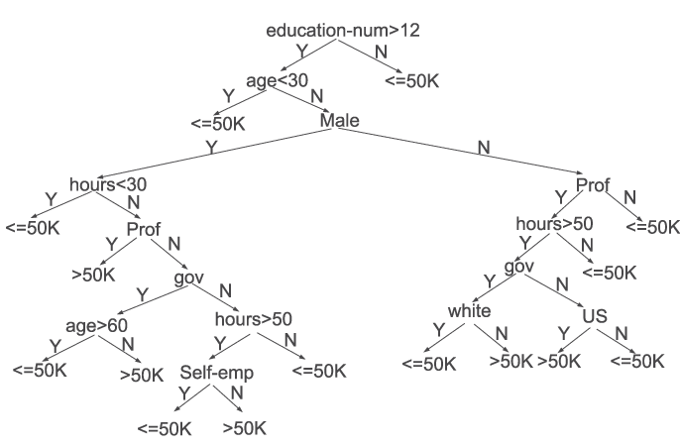
Tree-based model
A series of “if-then” rules to generate predictions from one or more decision trees
Decision Trees
Rule-based model
Non-parametric
Learn decision rules i.e.: yes/no questions from features in training data
One question = one node
https://arxiv.org/pdf/1508.03812.pdf

Slide 11
Decision Tree Induction: Example
Training data set: Buys_computer
The data set follows an example of Quinlan’s ID3 (Playing Tennis)
Resulting tree:
age?
<=30
overcast
>40
31..40
student?
yes
credit rating?
no
yes
excellent
fair
no
yes
no
yes

Slide 12
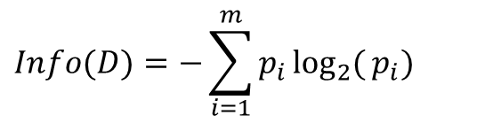
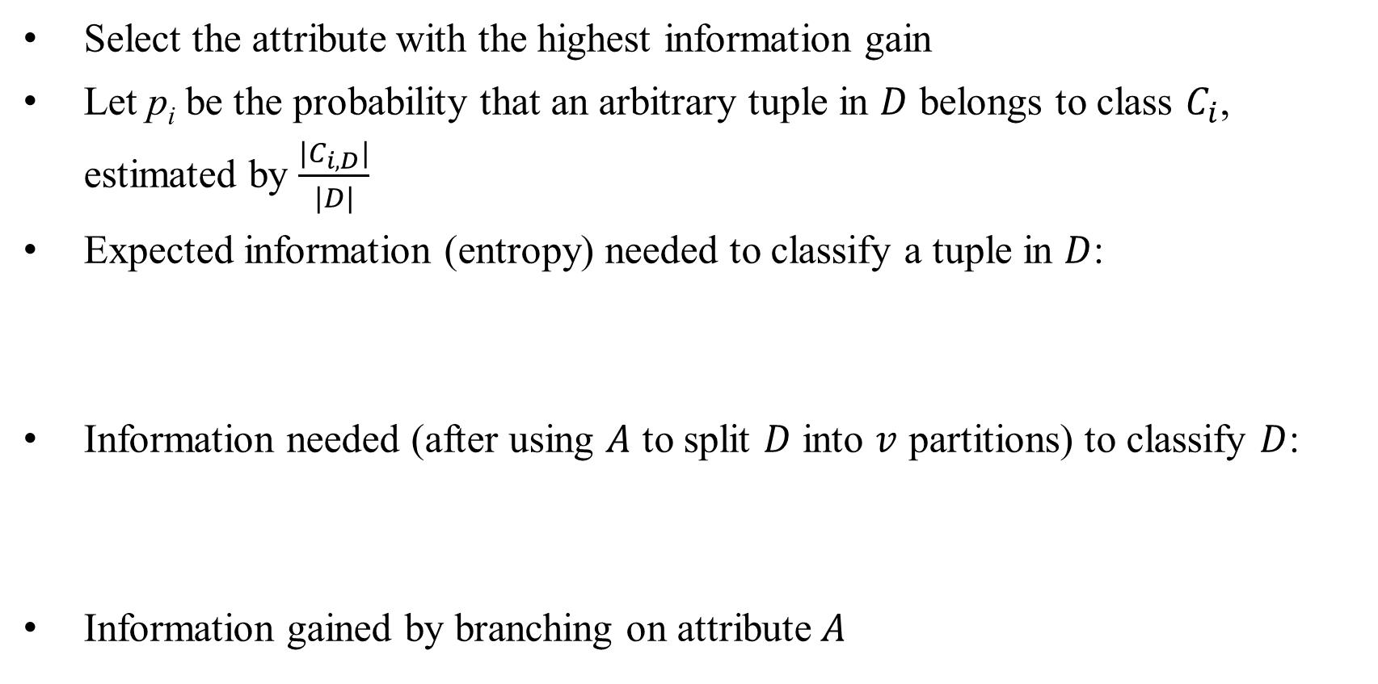
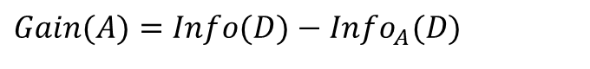
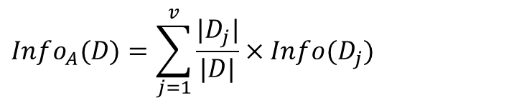
Attribute Selection Measure: Information Gain
Select the attribute with the highest information gain
Let p_{i} be the probability that an arbitrary tuple in $D$ belongs to class $C_{i}$, estimated by $\frac{|C_{i, D}|}{|D|}$
Expected information (entropy) needed to classify a tuple in $D$:
Information needed (after using $A$ to split $D$ into $v$ partitions) to classify $D$:
Information gained by branching on attribute $A$
$$Info(D)=−\sum_{i=1}^{m}{p_{i}}\log_{2}{(}p_{i})$$
$$Info_{A}(D)=\sum_{j=1}^{v}{\frac{|D_{j}|}{|D|}}×Info(D_{j})$$
$$Gain(A)=Info(D)−Info_{A}(D)$$

Slide 13
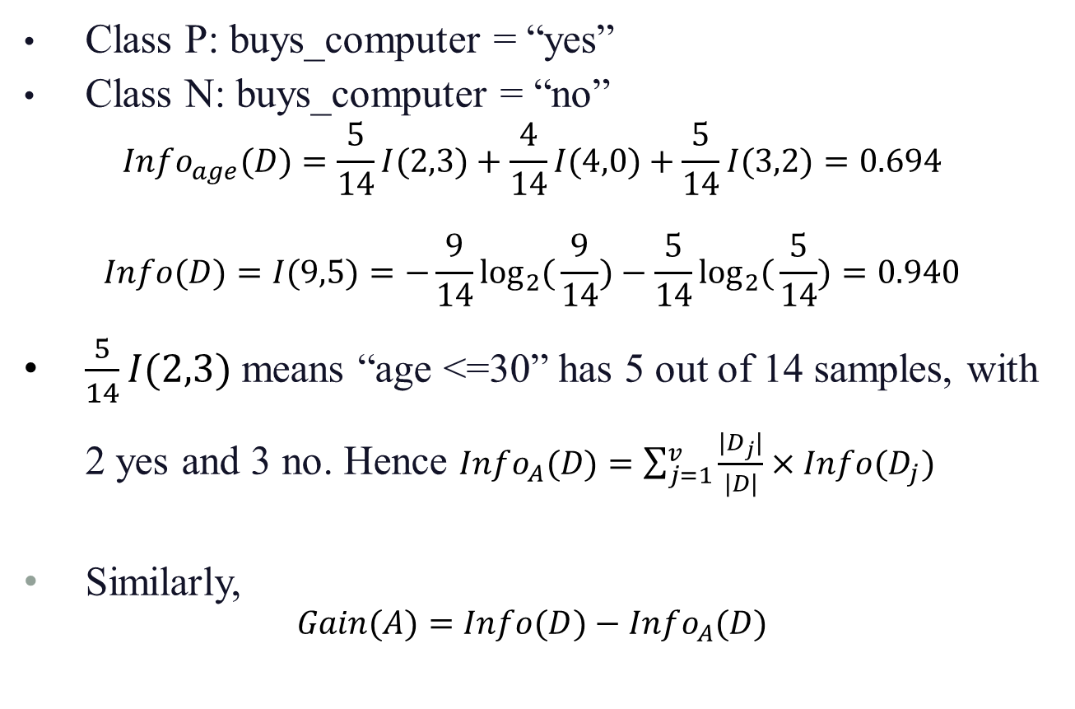
Attribute Selection: Information Gain
Class P: buys_computer = “yes”
Class N: buys_computer = “no”
$$Info_{age}(D)=\frac{5}{14}I(2,3)+\frac{4}{14}I(4,0)+\frac{5}{14}I(3,2)=0.694$$
$$Info(D)=I(9,5)=−\frac{9}{14}\log_{2}{(}\frac{9}{14})−\frac{5}{14}\log_{2}{(}\frac{5}{14})=0.940$$
$\frac{5}{14}I(2,3)$ means “age <=30” has 5 out of 14 samples, with 2 yes and 3 no. Hence $Info_{A}(D)=\sum_{j=1}^{v}{\frac{|D_{j}|}{|D|}}×Info(D_{j})$
Similarly,
$$Gain(A)=Info(D)−Info_{A}(D)$$
Notes:
Other attribute selection measures such as gini index

Slide 14
Decision Trees in scikit-learn
scikit-learn-decision-tree
scikit-learn implementation does not support categorical variables for now
Method
dtree = DecisionTreeClassifier()
dtree.fit(X_train, Y_train)
predictions = dtree.predict(X_test)

Slide 15
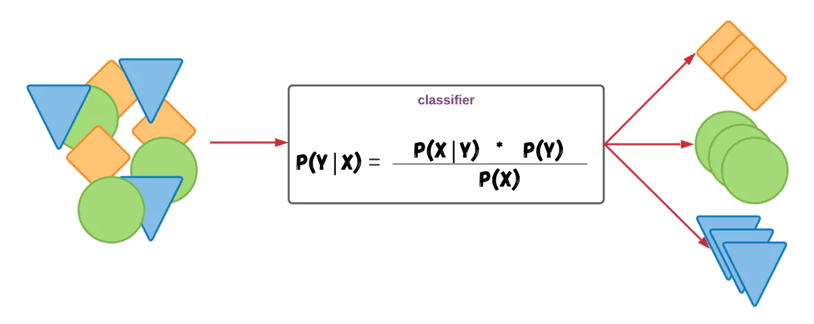
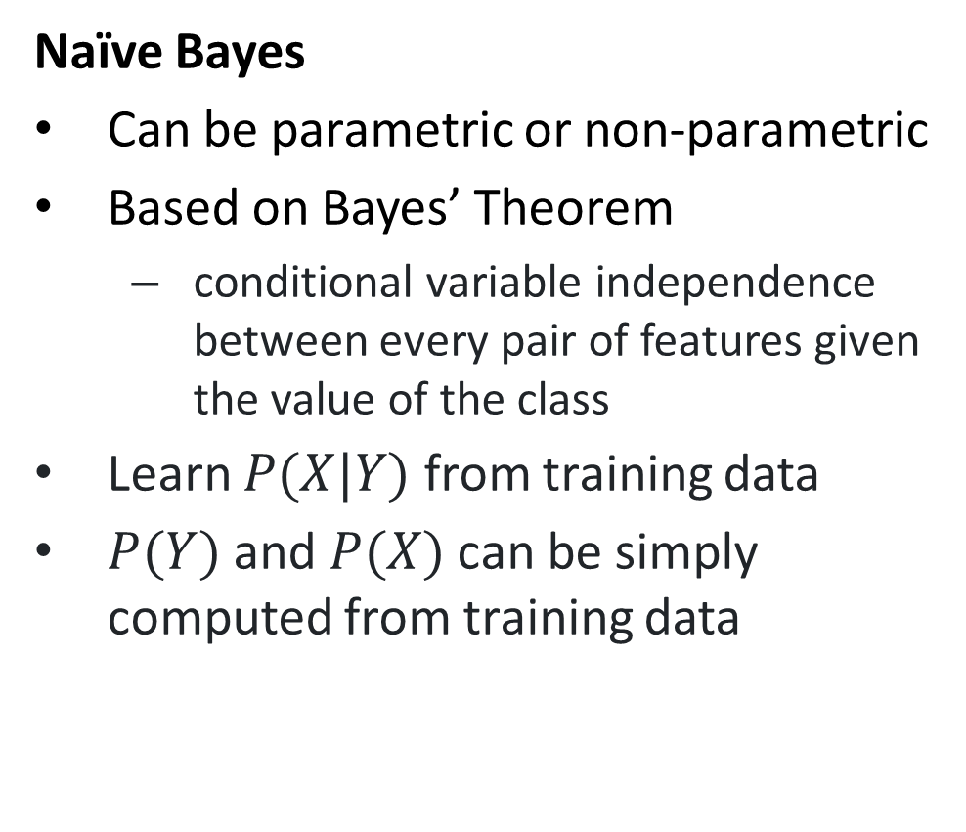
Probabilistic Model
Naïve Bayes
Can be parametric or non-parametric
Based on Bayes’ Theorem
conditional variable independence between every pair of features given the value of the class
Learn $P(X|Y)$ from training data
$P(Y)$ and $P(X)$ can be simply computed from training data
https://thinkinfi.com/naive-bayes-algorithm-in-machine-learning-with-python/

Slide 16
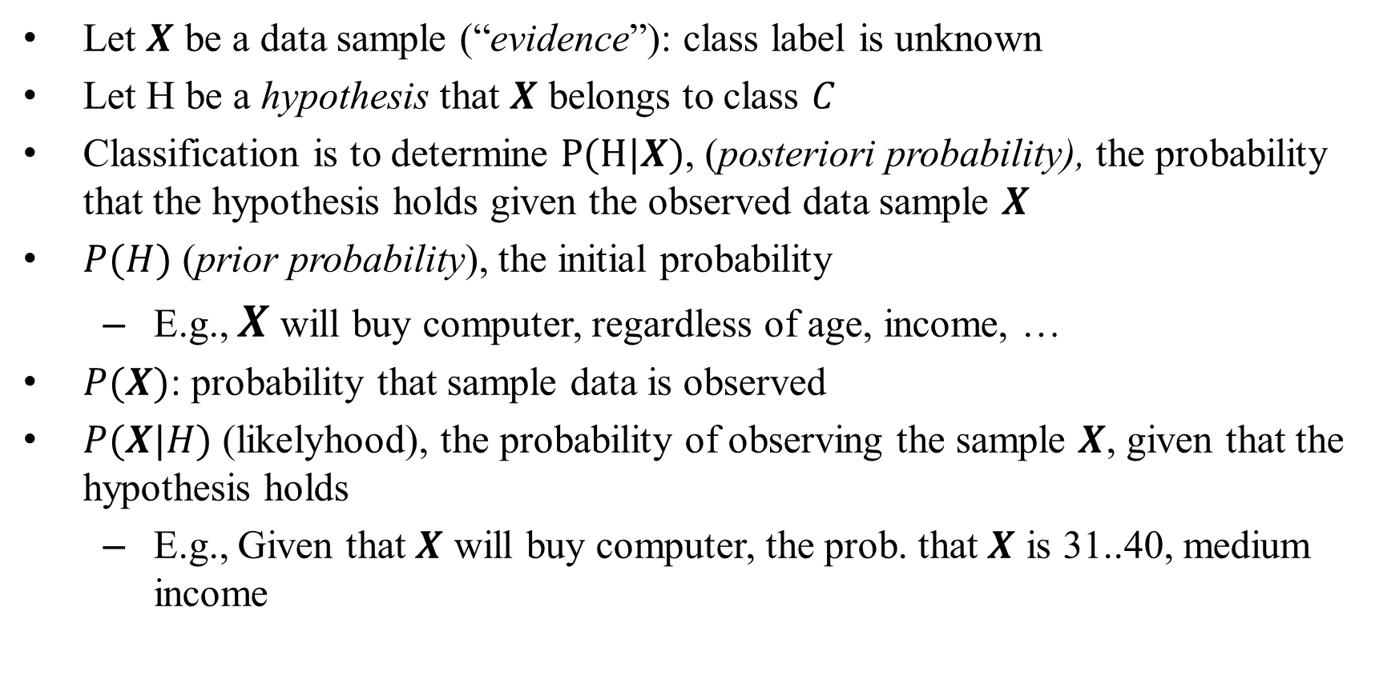
Bayesian Theorem
Let $X$ be a data sample (“evidence”): class label is unknown
Let H be a hypothesis that $X$ belongs to class $C$
Classification is to determine $P(H|X)$, (posteriori probability), the probability that the hypothesis holds given the observed data sample $X$
$P(H)$ (prior probability), the initial probability
E.g., $X$ will buy computer, regardless of age, income, …
$P(X)$: probability that sample data is observed
$P(X|H)$ (likelyhood), the probability of observing the sample $X$, given that the hypothesis holds
E.g., Given that $X$ will buy computer, the prob. that $X$ is 31..40, medium income

Slide 17
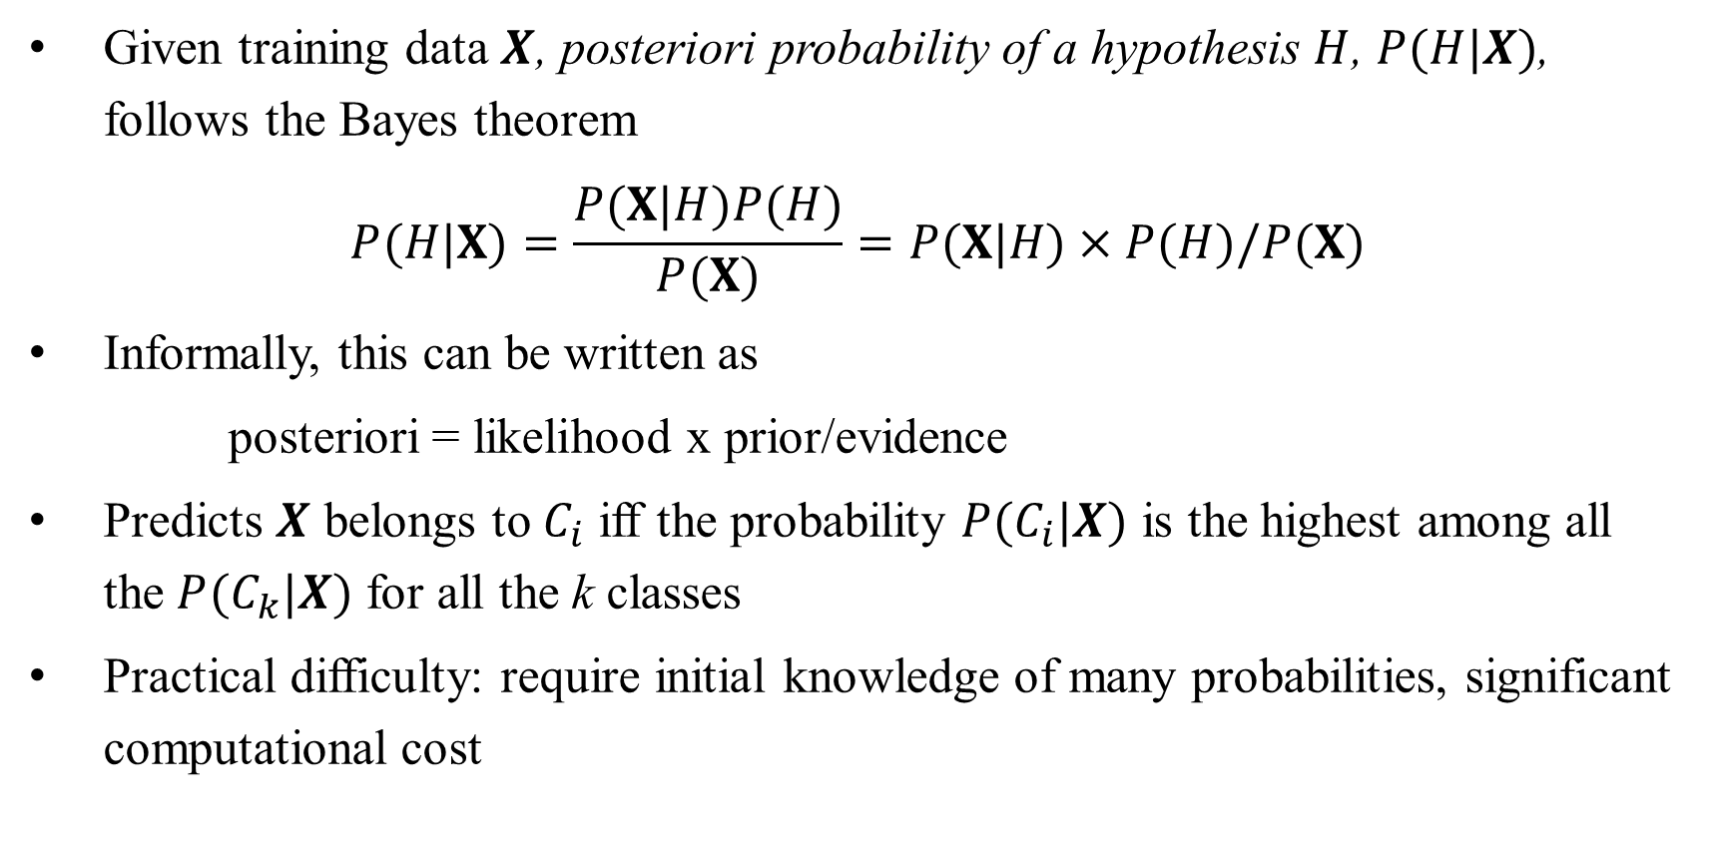
Bayesian Theorem
Given training data $X$, posteriori probability of a hypothesis $H$, $P(H|X)$, follows the Bayes theorem
$$P(H|X)=\frac{P(X|H)P(H)}{P(X)}=P(X|H)×P(H)/P(X)$$
Informally, this can be written as
posteriori = likelihood x prior/evidence
Predicts $X$ belongs to $C_{i}$ iff the probability $P(C_{i}|X)$ is the highest among all the $P(C_{k}|X)$ for all the k classes
Practical difficulty: require initial knowledge of many probabilities, significant computational cost

Slide 18
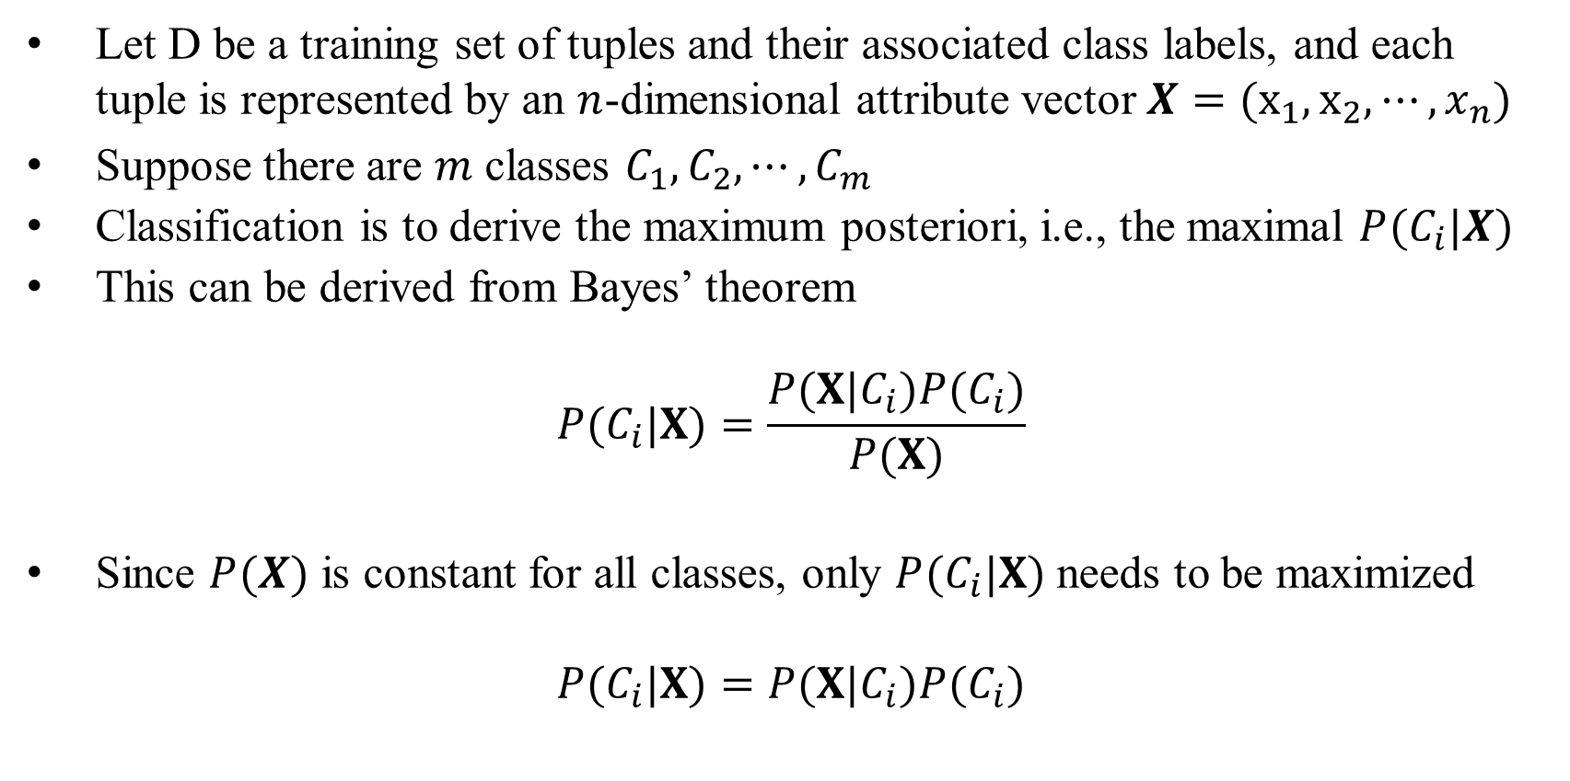
Naïve Bayes Classifier
Let D be a training set of tuples and their associated class labels, and each tuple is represented by an $n$-dimensional attribute vector $X=(x_{1},x_{2},⋯,x_{n})$
Suppose there are $m$ classes $C_{1}, C_{2}, ⋯, C_{m}$
Classification is to derive the maximum posteriori, i.e., the maximal $P(C_{i}|X)$
This can be derived from Bayes’ theorem
$$P(C_{i}|X)=\frac{P(X|C_{i})P(C_{i})}{P(X)}$$
Since $P(X)$ is constant for all classes, only $P(C_{i}|X)$ needs to be maximized
$$P(C_{i}|X)=P(X|C_{i})P(C_{i})$$

Slide 19
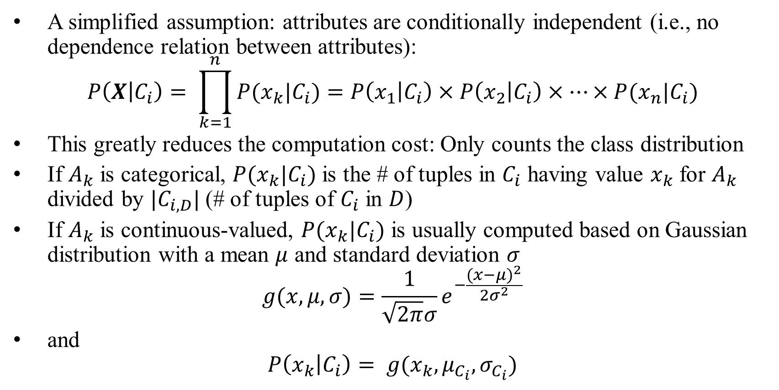
Naïve Bayes Classifier
A simplified assumption: attributes are conditionally independent (i.e., no dependence relation between attributes):
$$P\left(X | C_{i}\right)= \prod_{k=1}^{n}{P(x_{k}|C_{i})}=P\left(x_{1} | C_{i}\right)×P\left(x_{2} | C_{i}\right)×⋯×P(x_{n}|C_{i})$$
This greatly reduces the computation cost: Only counts the class distribution
If $A_{k}$ is categorical, $P(x_{k}|C_{i})$ is the # of tuples in $C_{i}$ having value $x_{k}$ for $A_{k}$ divided by $|C_{i,D}|$ (# of tuples of $C_{i}$ in $D$)
If $A_{k}$ is continuous-valued, $P(x_{k}|C_{i})$ is usually computed based on Gaussian distribution with a mean $μ$ and standard deviation $σ$
$$g(x,μ,σ)=\frac{1}{\sqrt{2π}σ}e^{−\frac{(x−μ)^{2}}{2σ^{2}}}$$
and
$$P\left(x_{k} | C_{i}\right)= g(x_{k},μ_{C_{i}},σ_{C_{i}})$$

Slide 20
Naïve Bayes Classifier: Example
Class:
C1:buys_computer = ‘yes’
C2:buys_computer = ‘no’
Data sample
X = age <=30,
Income = medium,
Student = yes,
Credit_rating = Fair

Slide 21
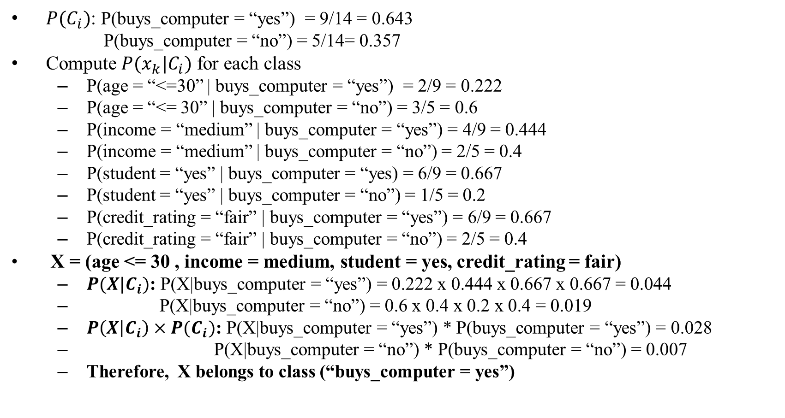
Naïve Bayes Classifier: Example
$P(C_{i})$: P(buys_computer = “yes”) = 9/14 = 0.643
P(buys_computer = “no”) = 5/14= 0.357
Compute $P(x_{k}|C_{i})$ for each class
P(age = “<=30” | buys_computer = “yes”) = 2/9 = 0.222
P(age = “<= 30” | buys_computer = “no”) = 3/5 = 0.6
P(income = “medium” | buys_computer = “yes”) = 4/9 = 0.444
P(income = “medium” | buys_computer = “no”) = 2/5 = 0.4
P(student = “yes” | buys_computer = “yes) = 6/9 = 0.667
P(student = “yes” | buys_computer = “no”) = 1/5 = 0.2
P(credit_rating = “fair” | buys_computer = “yes”) = 6/9 = 0.667
P(credit_rating = “fair” | buys_computer = “no”) = 2/5 = 0.4
X = (age <= 30 , income = medium, student = yes, credit_rating = fair)
$P(X|C_{i})$: P(X|buys_computer = “yes”) = 0.222 x 0.444 x 0.667 x 0.667 = 0.044
P(X|buys_computer = “no”) = 0.6 x 0.4 x 0.2 x 0.4 = 0.019
$P\left(X | C_{i}\right)×P(C_{i})$: P(X|buys_computer = “yes”) * P(buys_computer = “yes”) = 0.028
P(X|buys_computer = “no”) * P(buys_computer = “no”) = 0.007
Therefore, X belongs to class (“buys_computer = yes”)

Slide 22
Naïve Bayes in scikit-learn
scikit-learn-naive-bayes
GaussianNB implements the Gaussian Naive Bayes algorithm for classification.
Method
gnb = GaussianNB()
gnb.fit(X_train, Y_train)
predictions = gnb.predict(X_test)

Slide 23
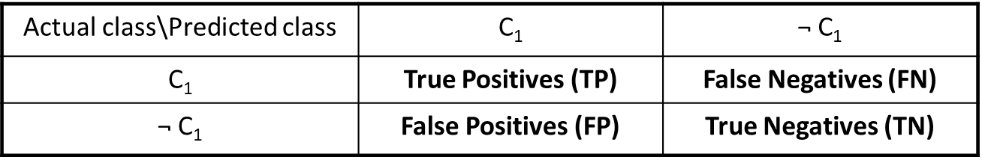
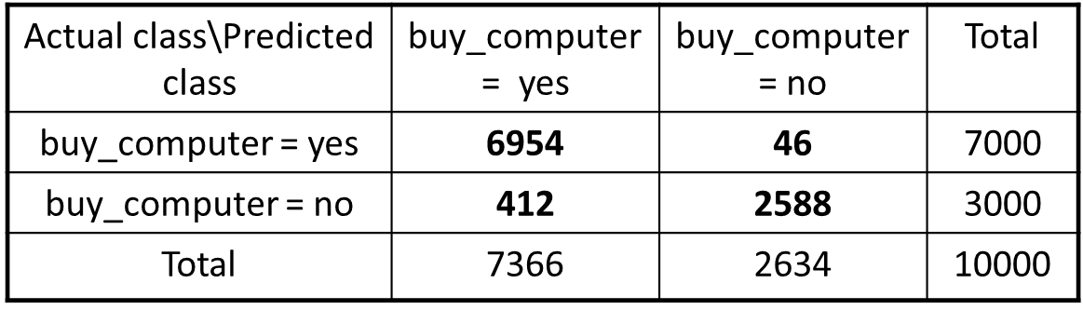
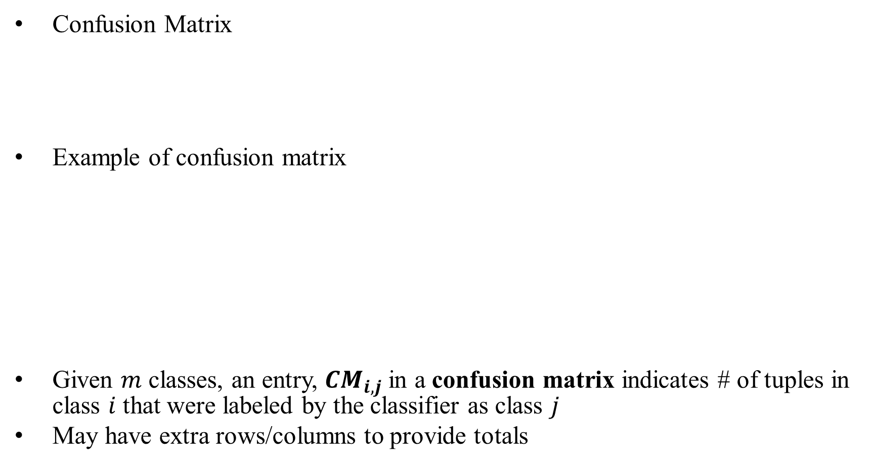
Classifier Evaluation: Confusion Matrix
Confusion Matrix
Example of confusion matrix
Given $m$ classes, an entry, $CM_{i,j}$ in a confusion matrix indicates # of tuples in class $i$ that were labeled by the classifier as class $j$
May have extra rows/columns to provide totals

Slide 24
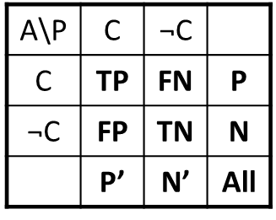
Classifier Evaluation Metrics
Classifier Accuracy, or recognition rate: percentage of test set tuples that are correctly classified
Accuracy = (TP + TN)/All
Error rate = 1 – Accuracy, or
Error rate = (FP + FN)/All
Class Imbalance Problem:
One class may be rare, e.g. fraud, or HIV-positive
Significant majority of the negative class and minority of the positive class
Sensitivity: True Positive recognition rate
Sensitivity = TP/P
Specificity: True Negative recognition rate
Specificity = TN/N

Slide 25
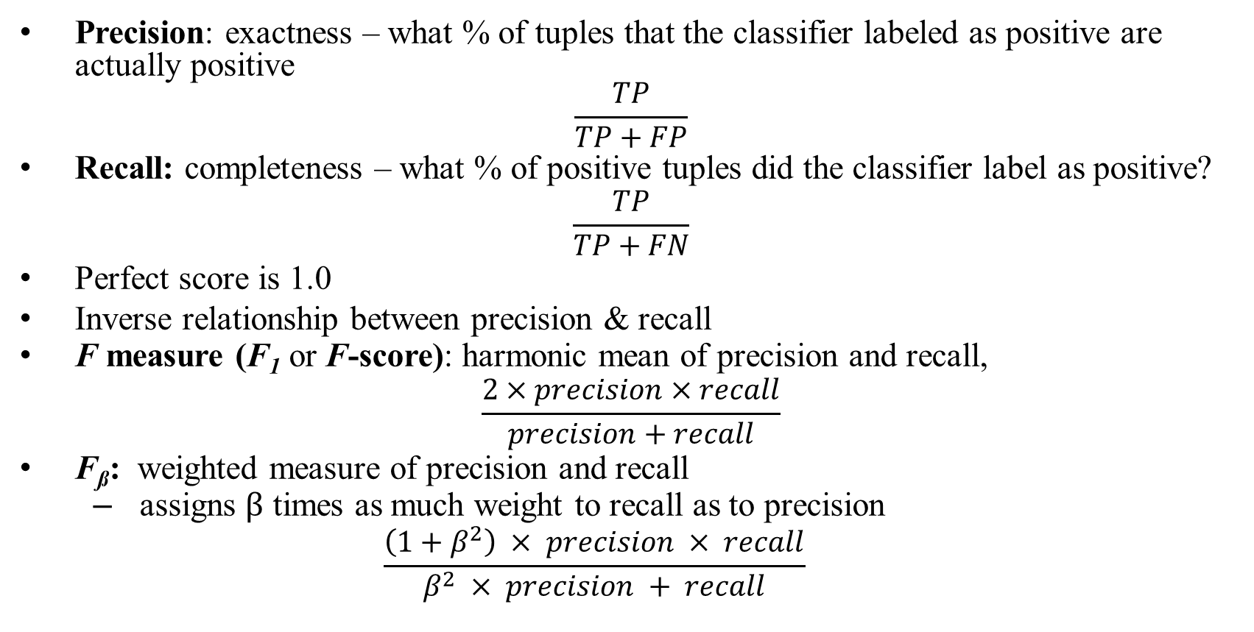
Classifier Evaluation Metrics
Precision: exactness – what % of tuples that the classifier labeled as positive are actually positive
$$\frac{TP}{TP+FP}$$
Recall: completeness – what % of positive tuples did the classifier label as positive?
$$\frac{TP}{TP+FN}$$
Perfect score is 1.0
Inverse relationship between precision & recall
F measure (F₁ or F-score): harmonic mean of precision and recall,
$$\frac{2×precision×recall}{precision+recall}$$
F_{ß}: weighted measure of precision and recall
assigns $β$ times as much weight to recall as to precision
$$\frac{\left(1+β^{2}\right) × precision × recall}{β^{2} × precision + recall}$$

Slide 26
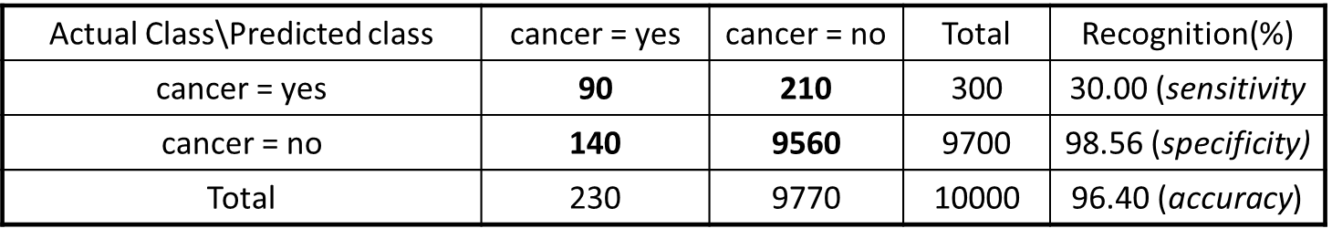
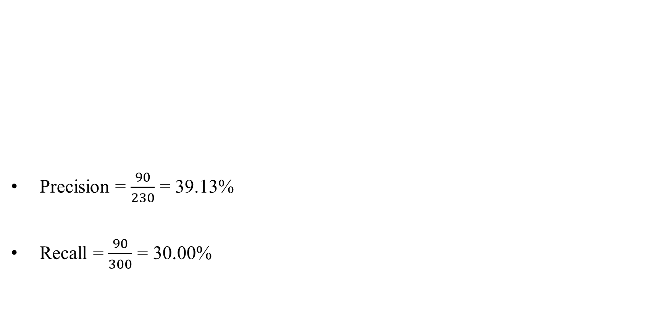
Classifier Evaluation Metrics: Example
Precision = $\frac{90}{230}$ = 39.13%
Recall = $\frac{90}{300}$ = 30.00%

Slide 27
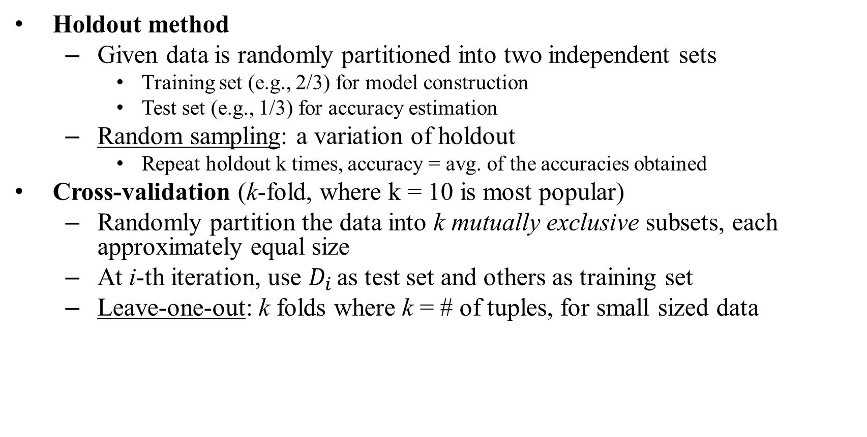
Classifier Evaluation
Holdout method
Given data is randomly partitioned into two independent sets
Training set (e.g., 2/3) for model construction
Test set (e.g., 1/3) for accuracy estimation
Random sampling: a variation of holdout
Repeat holdout k times, accuracy = avg. of the accuracies obtained
Cross-validation (k-fold, where k = 10 is most popular)
Randomly partition the data into k mutually exclusive subsets, each approximately equal size
At i-th iteration, use $D_{i}$ as test set and others as training set
Leave-one-out: k folds where k = # of tuples, for small sized data

Slide 28
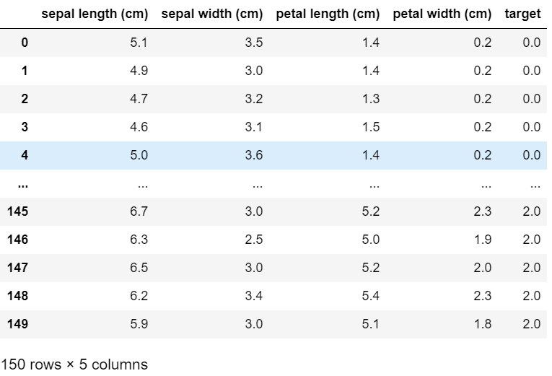
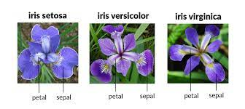
Dataset: Iris

Slide 29
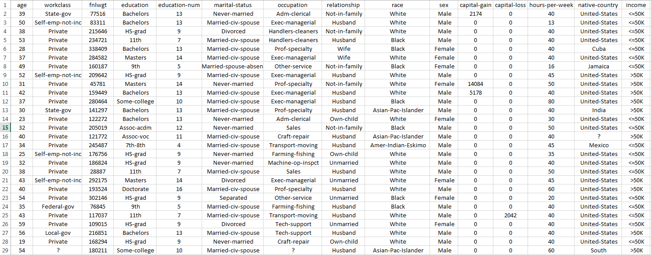
Dataset: Adult

Slide 30
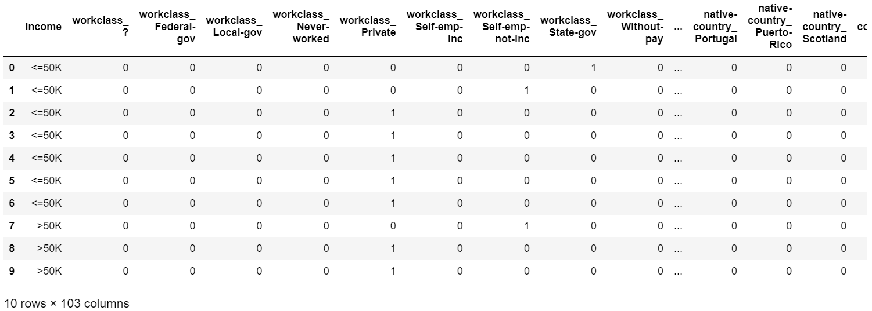
Dataset: Pre-processed Adult

Slide 31
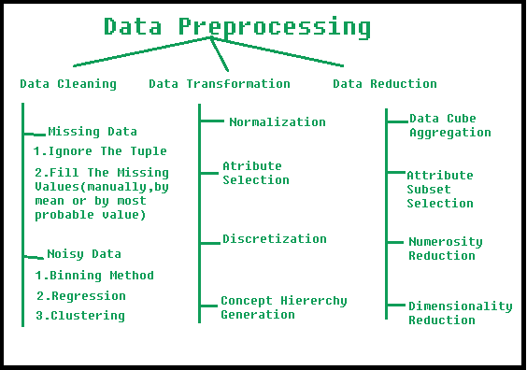
Data Preprocessing
Manipulation of data before use
Transform plain-text information to numerical data that can be used in computations
Fill or discard missing values
One-hot encoding
Transform numerical attributes to specific ranges
Reduce dimensions
https://www.geeksforgeeks.org/data-preprocessing-in-data-mining/

Slide 32
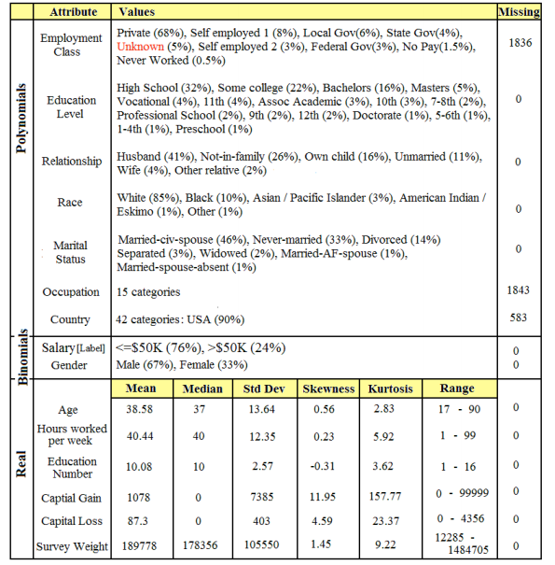
Data Preprocessing
How do we decide?
Domain knowledge
Analyze data statistics; you can do this analysis with Pandas and NumPy

Slide 33
Data Preprocessing: Adult
We will perform the following operations
Refer to Task 1/2 notebooks for code
Clean data
Remove “.” from income
Remove “?” records (missing value amputation)
Reduce dimensions
Select only categorical attributes
Transform
One-hot encoding
Normalization
Discretization
Add missing attributes

Slide 34
Tasks
Task 1
Remove records with unknown (?) values from both train and test data sets and remove all continuous attributes. For each multi-domain categorical attribute, use one-hot encoding to transform data
Build a decision tree classifier (single tree) and report accuracy by class including (TP rate, FP rate, precision, recall, F1) on the test data
Build a naïve Bayesian classifier and report accuracy by class including (TP rate, FP rate, precision, recall, F1) on the test data
Task 2
Additionally for each numerical attribute, use the mean value to transform into binary attribute
Build a logistic regression classifier and report the predicted accuracy on the test data.
Build a SVM classifier and report the predicted accuracy on the test data.
Build a neural network classifier and report the predicted accuracy on the test data.

Slide 35
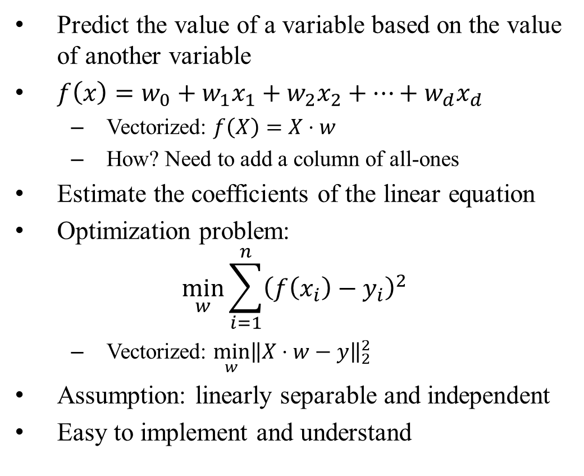
Linear Regression
Predict the value of a variable based on the value of another variable
$f\left(x\right)=w_{0}+w_{1}x_{1}+w_{2}x_{2}+⋯+w_{d}x_{d}$
Vectorized: $f\left(X\right)=X⋅w$
How? Need to add a column of all-ones
Estimate the coefficients of the linear equation
Optimization problem:
$$\min_{w}{\sum_{i=1}^{n}{{\left(f\left(x_{i}\right)−y_{i}\right)}^{2}}}$$
Vectorized: $\min_{w}{{\left\|X⋅w−y\right\|}_{2}^{2}}$
Assumption: linearly separable and independent
Easy to implement and understand

Slide 36
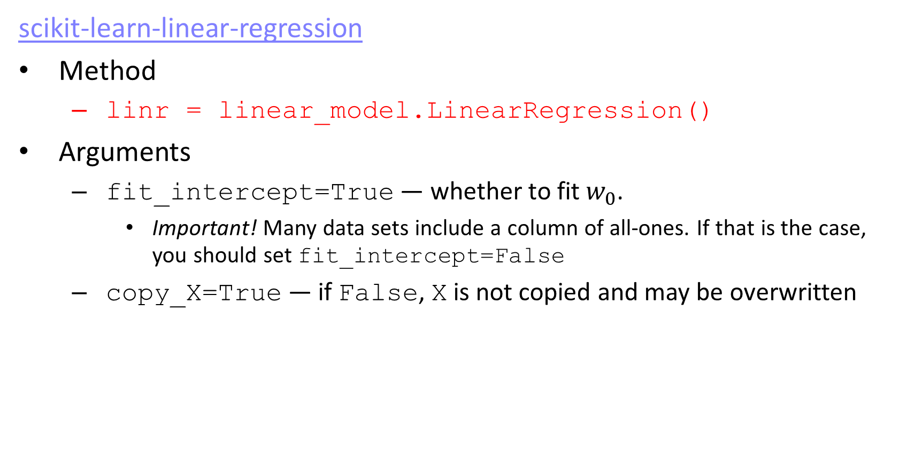
Linear Regression in scikit-learn
scikit-learn-linear-regression
Method
linr = linear_model.LinearRegression()
Arguments
fit_intercept=True — whether to fit $w_{0}$.
Important! Many data sets include a column of all-ones. If that is the case, you should set fit_intercept=False
copy_X=True — if False, X is not copied and may be overwritten

Slide 37
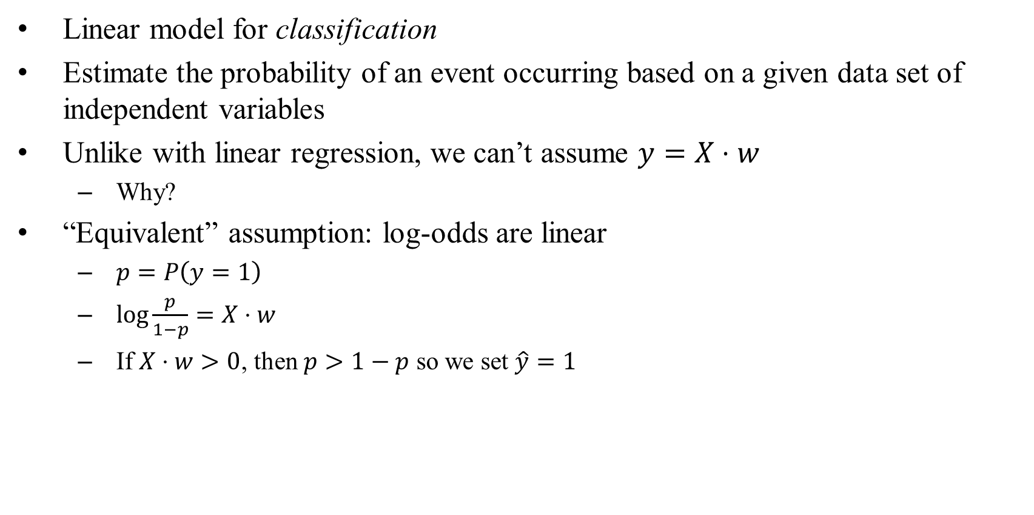
Logistic Regression
Linear model for classification
Estimate the probability of an event occurring based on a given data set of independent variables
Unlike with linear regression, we can’t assume $y=X⋅w$
Why?
“Equivalent” assumption: log-odds are linear
$p=P\left(y=1\right)$
$\log{\frac{p}{1−p}=X⋅w}$
If $X⋅w>0$, then $p>1−p$ so we set $\hat{y}=1$

Slide 38
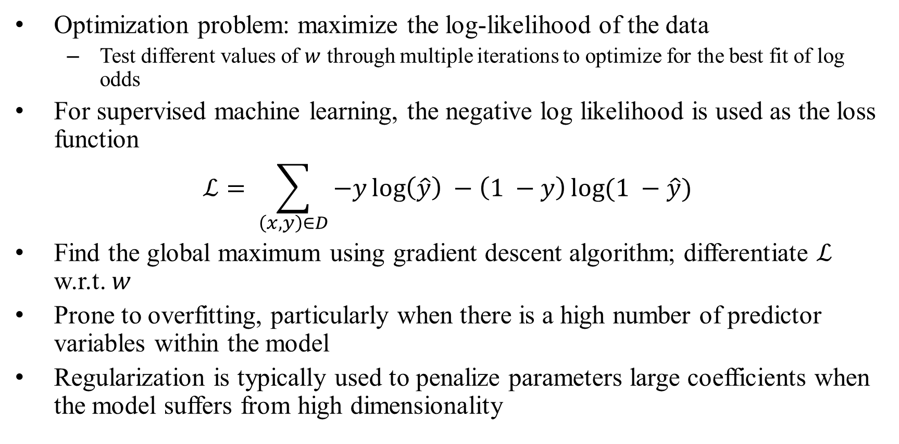
Logistic Regression
Optimization problem: maximize the log-likelihood of the data
Test different values of $w$ through multiple iterations to optimize for the best fit of log odds
For supervised machine learning, the negative log likelihood is used as the loss function
$$ℒ= \sum_{\left(x,y\right)∈D}{−y\log\left(\hat{y}\right) −\left(1 −y\right)\log{(1 −\hat{y})}}$$
Find the global maximum using gradient descent algorithm; differentiate $ℒ$ w.r.t. $w$
Prone to overfitting, particularly when there is a high number of predictor variables within the model
Regularization is typically used to penalize parameters large coefficients when the model suffers from high dimensionality

Slide 39
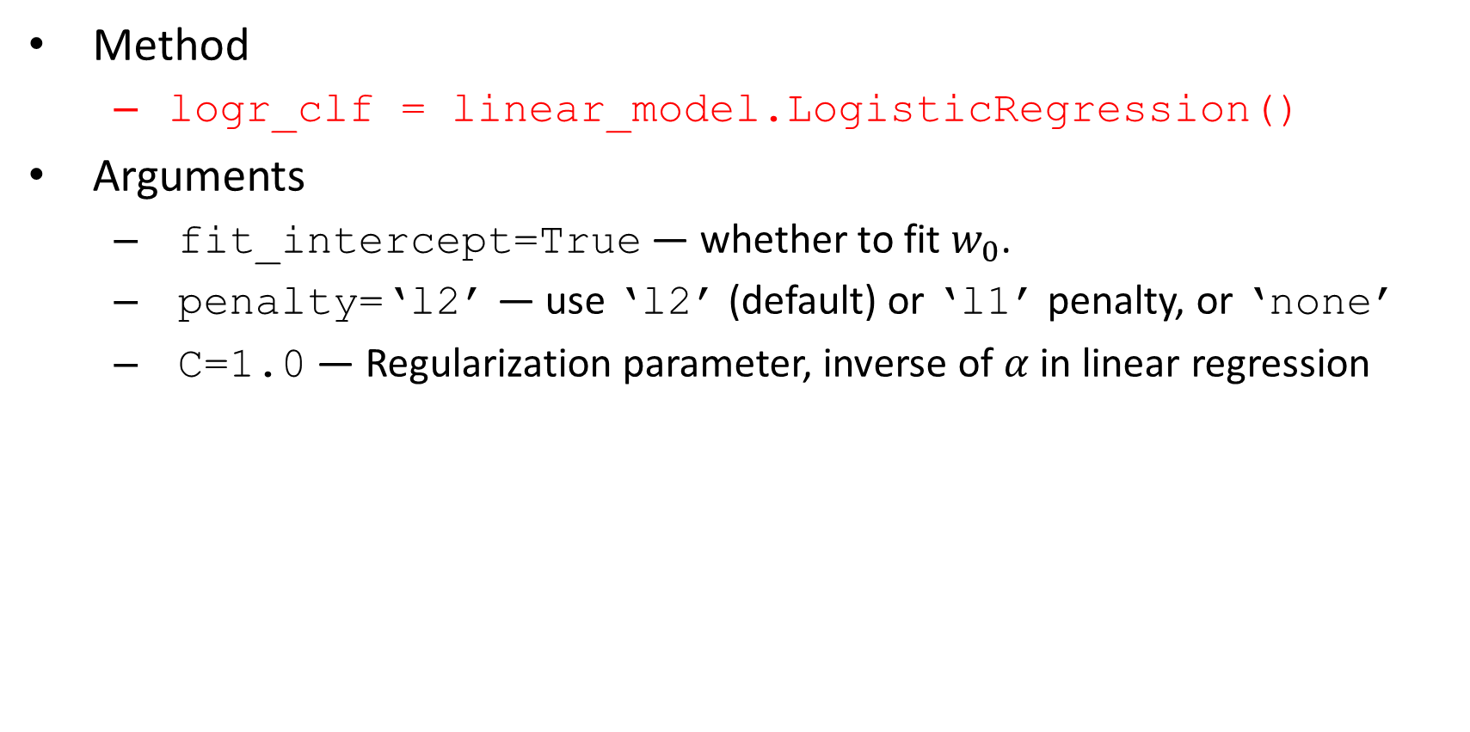
Logistic Regression in scikit-learn
Method
logr_clf = linear_model.LogisticRegression()
Arguments
fit_intercept=True — whether to fit $w_{0}$.
penalty=‘l2’ — use ‘l2’ (default) or ‘l1’ penalty, or ‘none’
C=1.0 — Regularization parameter, inverse of $α$ in linear regression

Slide 40
Non-linearity
Notes:
Hyperplane

Slide 41
Support Vector Machines
Linear Classifier
Find a line or a plane that separates positive and negative examples
Uses a subset of training points in the decision function (called support vectors)
Given a set of linearly separable training examples
D = {(x₁, y₁), (x₂, y₂), …, (x_{n}, y_{n})}
Solve the constrained minimization problem
⟨w ⋅ x_{i}⟩ + b ≥ 1 for y_{i} = 1
⟨w ⋅ x_{i}⟩ + b ≤ -1 for y_{i} = -1.

Slide 42
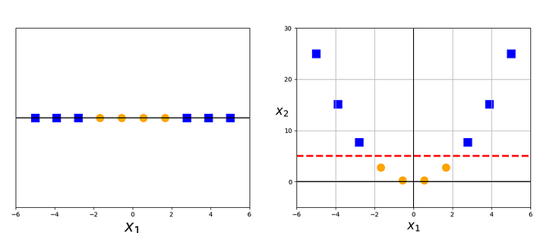
Support Vector Machines
Data may be linearly non-separable in the 2-D space
Space transformation: Map data points from input space to feature space
Incorporates the kernel trick, so complex non-linearities can be added
Cool trick: Gaussian kernel corresponds to infinite features
Any data set becomes linear with a sufficiently fine-grained Gaussian kernel
Note: it is not always a good idea to make your data perfectly linearly separable!
Adds another constraint: focuses only on points near the decision boundary; support vectors
Notes:
Issues: no categorical values
Only 2-class classification, one-vs-rest techniques and so on for multi-class
Hard to interpret the hyperplane in high dimension

Slide 43
SVMs in scikit-learn
scikit-learn-svm
Method
svm_clf = svm.SVC()
Arguments
C=1.0 — regularization parameter, as in logistic regression
kernel=‘rbf’ — the type of kernel to use
‘rbf’ — Gaussian or radial basis function kernel
‘linear’ — Introduces no non-linearities
‘poly’ — polynomial non-linearities
degree — of the polynomial in ‘poly’
gamma — smaller gamma means more complex non-linearities for ‘rbf’
probability=False — whether to enable probability estimates
decision_function=‘ovr’ — how to handle multi-class classification
‘ovr’ — one-vs-rest: one model for each class
‘ovo’ — one-vs-one: one model for each pair of classes (quadratically many!)

Slide 44
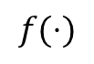
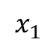

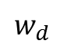
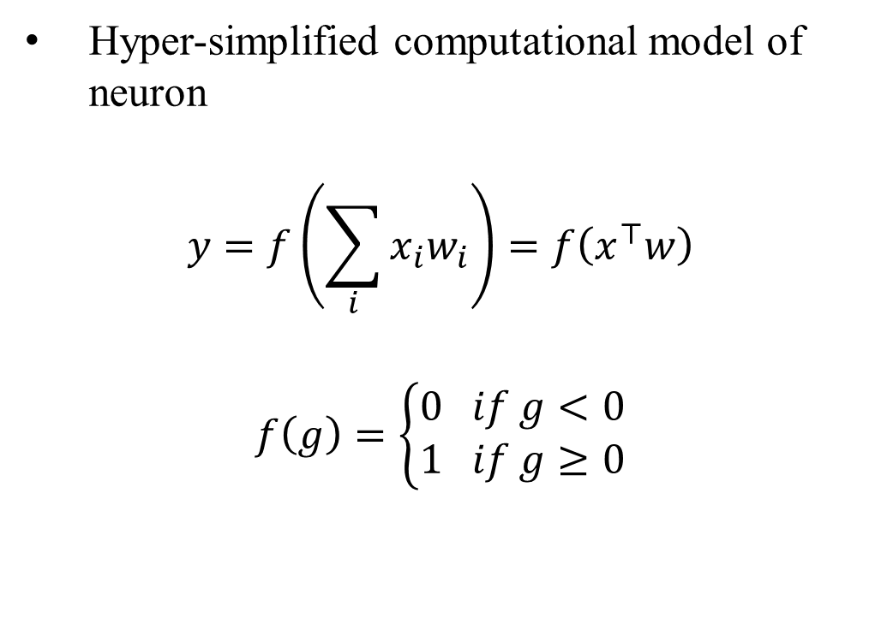

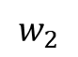
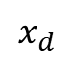
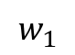
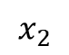
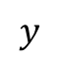
Perceptron
Hyper-simplified computational model of neuron
$$y=f\left(\sum_{i}{x_{i}w_{i}}\right)=f\left(x^{⊤}w\right)$$
$$f\left(g\right)=\left\{\begin{aligned}0 if g<0 \\ 1 if g≥0\end{aligned}\right.$$
$$x_{1}$$
$$w_{1}$$
$$x_{2}$$
$$w_{2}$$
$$Σ$$
$$f(⋅)$$
$$y$$
$$⋯$$
$$w_{d}$$
$$x_{d}$$
(step function)

Slide 45
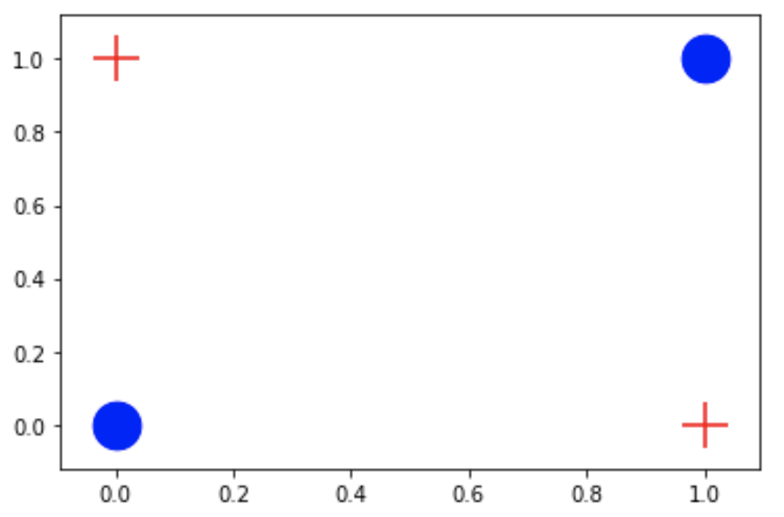
Problem with the perceptron
It is too simple, and can’t learn complex functions
The classic example: XOR
There is no perceptron (weight assignment) that can solve the XOR
This shouldn’t be surprising… it’s just a linear classifier!

Slide 46
Artificial neural networks
If we can make neurons, we can make a whole brain, too
Human brain has 100 billion neurons. We can’t make neural nets with 100 billion of these…
Plus real neurons and their connections are way more complex
Each node represents a perceptron or neuron
Each edge represents a weight
hidden layers
input layer(x)
output layer(y)
width
depth

Slide 47
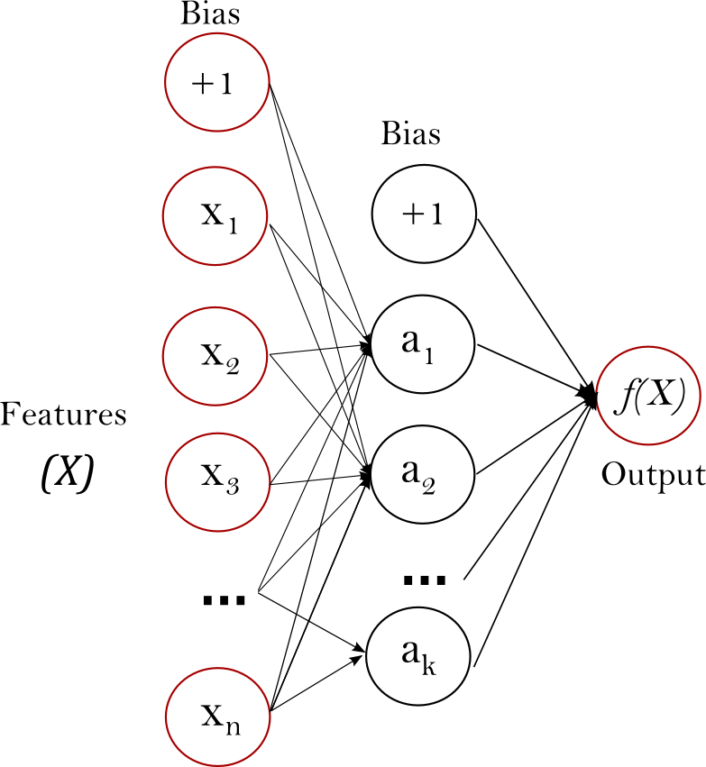
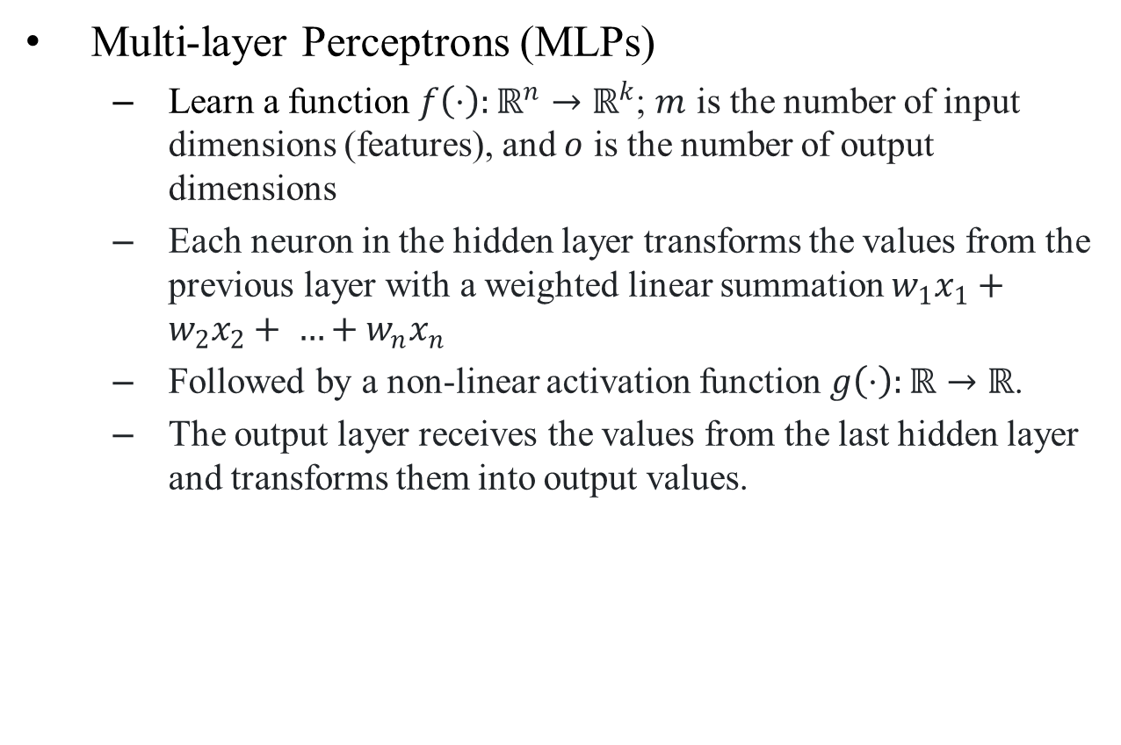
Neural Networks
Multi-layer Perceptrons (MLPs)
Learn a function $f\left(⋅\right):ℝ^{n}→ℝ^{k}$; $m$ is the number of input dimensions (features), and $o$ is the number of output dimensions
Each neuron in the hidden layer transforms the values from the previous layer with a weighted linear summation $w_{1}x_{1}+w_{2}x_{2}+ …+w_{n}x_{n}$
Followed by a non-linear activation function $g\left(⋅\right):ℝ→ℝ$.
The output layer receives the values from the last hidden layer and transforms them into output values.

Slide 48
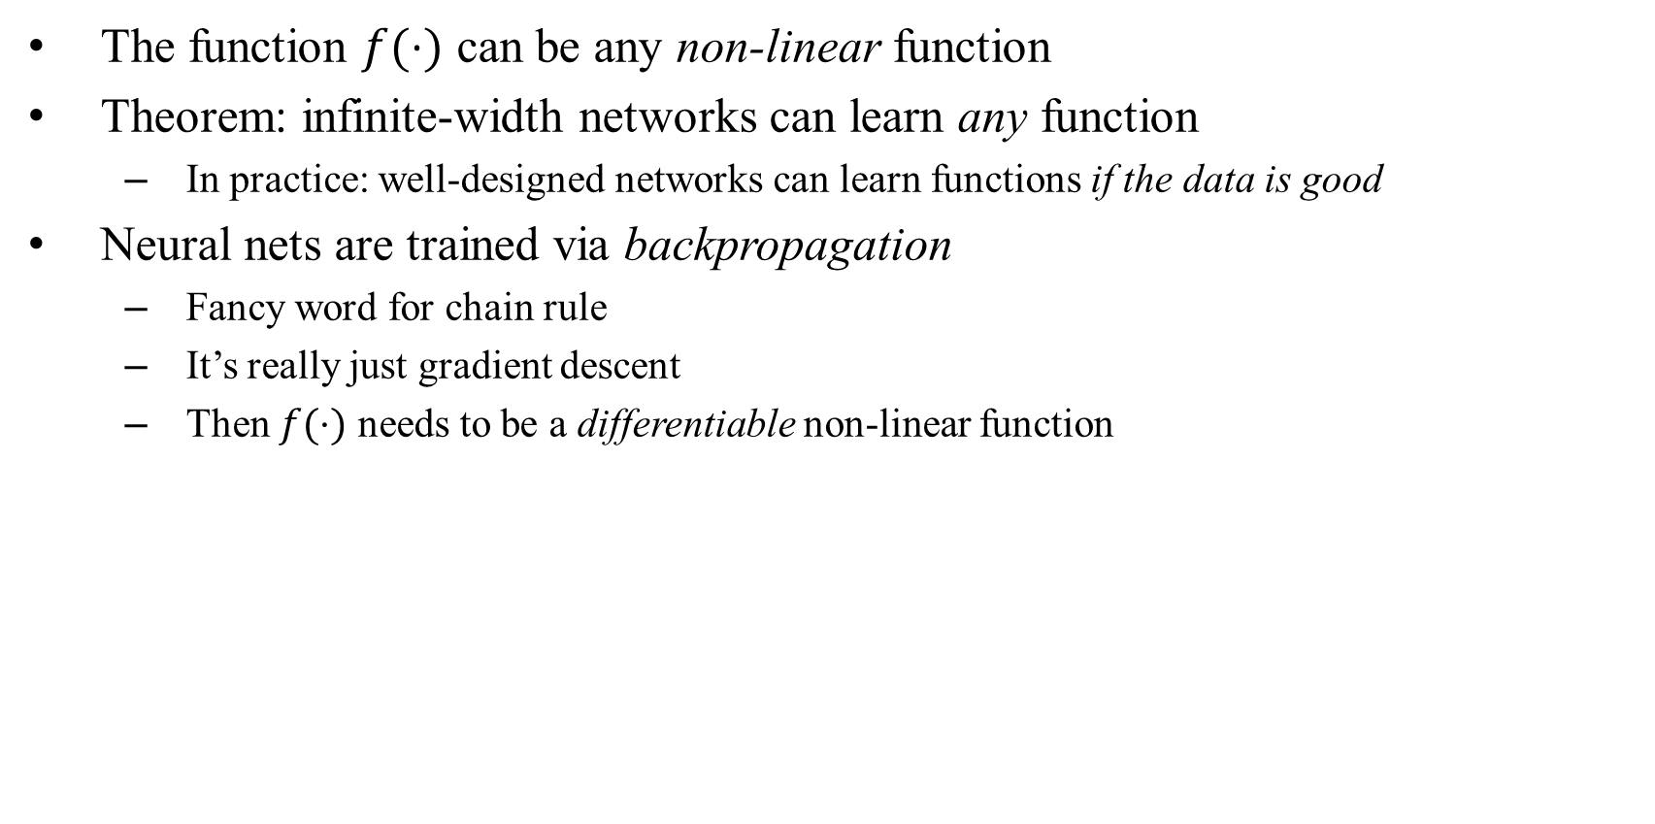
Neural Networks
The function $f(⋅)$ can be any non-linear function
Theorem: infinite-width networks can learn any function
In practice: well-designed networks can learn functions if the data is good
Neural nets are trained via backpropagation
Fancy word for chain rule
It’s really just gradient descent
Then $f(⋅)$ needs to be a differentiable non-linear function

Slide 49
Neural Networks in scikit-learn
scikit-learn-nn-mlp
Method
mlp = neural_network.MLPClassifier()
Arguments
hidden_layer_sizes=(100,10,) – array of number of neurons in each layer
activation=‘relu’ – non-linearity for the hidden layers
solver=‘sgd’ – weight optimization method
alpha=0.0001 – strength of L2 regularization
learning_rate_init=0.001 – step-size for updating weights

Slide 50
There’s much more to scikit-learn
Resources
https://scikit-learn.org/stable/
You can find example implementations of various classification models
You can also find examples of data preprocessing techniques
Further Reading: PyTorch
Python package with more capabilities
Tensor computation with strong GPU acceleration
Examples: https://github.com/pytorch/examples
Tutorials: https://github.com/yunjey/pytorch-tutorial

